Slide 1
SPEC Pro 6000 Protective Type Inductively
Coupled Plasma Optical Emission Spectrometer
Hangzhou EXPEC Technology Co., LTD

Slide 2
目录
1
SPEC Pro 6000 System Composition
2
Design Features and Instrument Performance
3
Function Introduction of SPEC Pro 6000
4
Configuration and Application Cases

Slide 3
1
SPEC Pro 6000 System Composition
Part
Notes:
方案背景：如何推广“超级水站”，与常规水站不同，应聚焦“环境风险”。然后从典型水污染事件讲环境风险

Slide 4
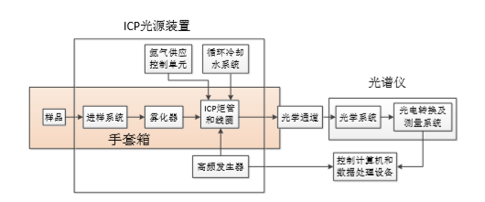
System Composition Diagram
The host machine configuration of protective inductively coupled plasma spectrometer, including sampling system, plasma torch, optical channel, detector, high frequency generator, computer control system, cooling system, gas supply system, exhaust system, glove box, etc.
Notes:
重新作图

Slide 5
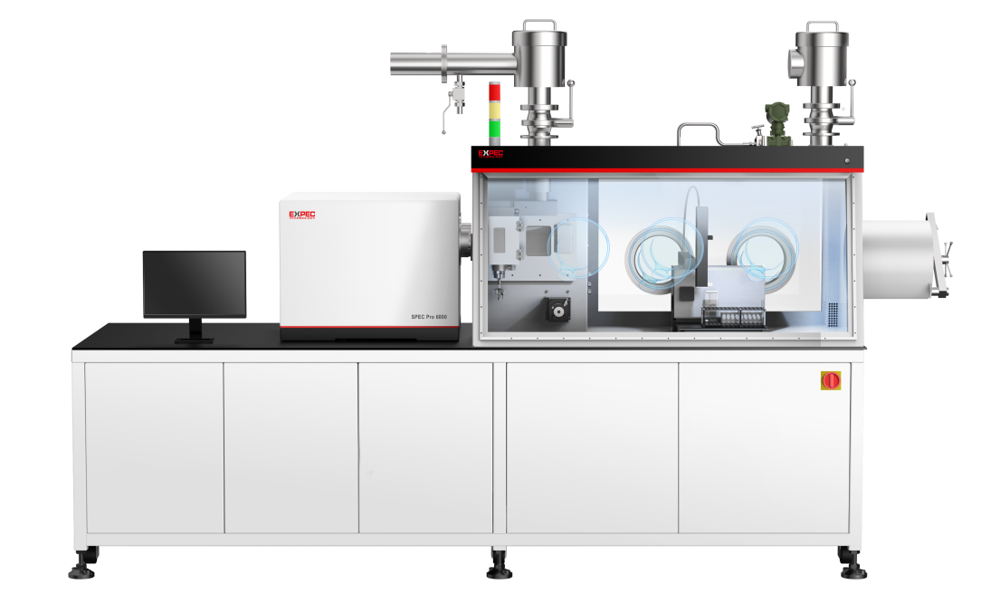
Protective type of ICP-OES SPEC Pro 6000
SPEC Pro 6000 protective type inductively coupled plasma optical emission spectrometer, using a split design, Combining an ICP-OES with a Glove Box, sample contact parts in the glove box chamber, through the glove mounted on the wall of the chamber to operate the sample inside the chamber, play the role of dust and radiation protection. Can be used in food, biology, disease control and nuclear industry and other fields.
Air exhaust filter
Unique design of exhaust pipe to ensure that exhaust gas does not enter the laboratory and prevent laboratory contamination
Sample access to the system
It can be used with fully automatic pretreatment equipment
Material transition compartment and tool transition compartment, placement and delivery of samples
Mature analytical techniques
Mature element analysis technique based on ICP-OES
Closed operating space
Split design
Seal off the operating environment of the glove box
Instrument automatic ignition, automatic optimization, automatic calibration curve, automatic quality control
The host actively starts, optimizes, and prepares for the analysis
Standard solution automatic introduction, quality control includes detection limit, standard sample, blank and other choices, to ensure the reliability of data
Closed digestion system and waste recycling
Made of lead glass. Stainless steel and other materials close the digestion chamber and recover waste and liquid after analysis to avoid pollution

Slide 6
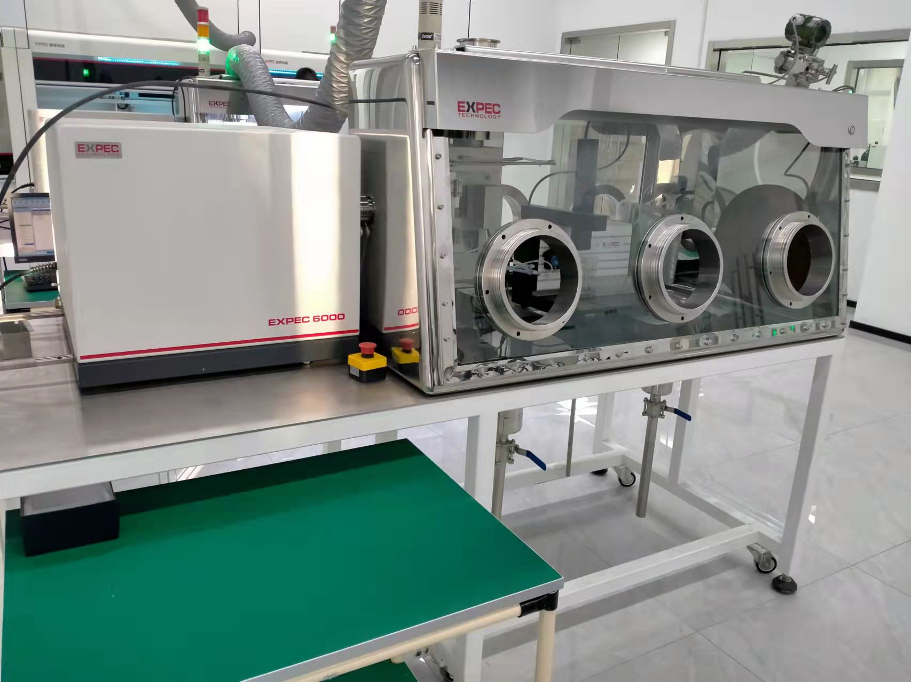
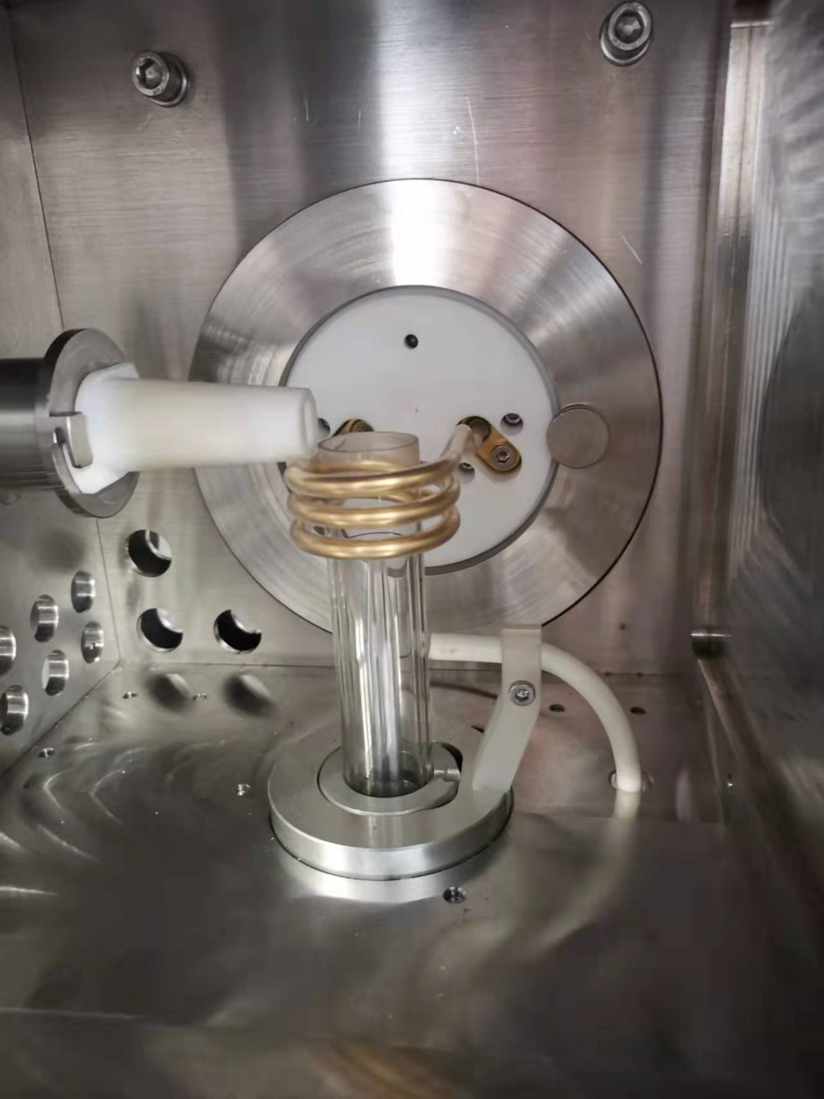
Protective type of ICP-OES SPEC Pro 6000

Slide 7
2
Design Features and Instrument Performance
Part
Notes:
方案背景：如何推广“超级水站”，与常规水站不同，应聚焦“环境风险”。然后从典型水污染事件讲环境风险

Slide 8
Design Feature
Optical system design -Extended optical channel between the instrument and the glove box to achieve a sealed design
Torch chamber design -Torch chamber door adopts straight pull design, ionization prevention, easy to open and close
RF power supply design -RF power supply module is separately encapsulated in the back panel of the glove box in a shaped place
Penetration design -Integrated design of the penetration ensures hermeticity
Glove box design -Customized glove box, the box can achieve a variety of closed environment
Easy accessory replacement and maintenance -Easy maintenance and replacement of instrument components in the glove box to reduce maintenance costs

Slide 9
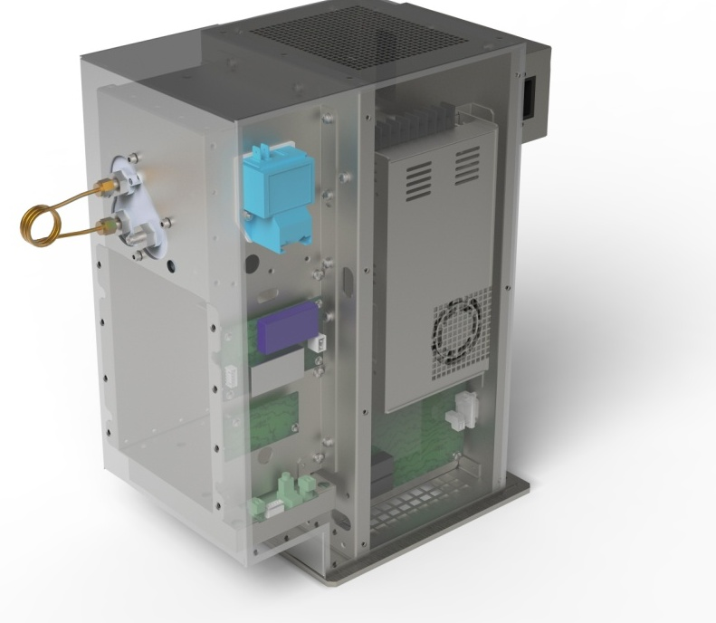
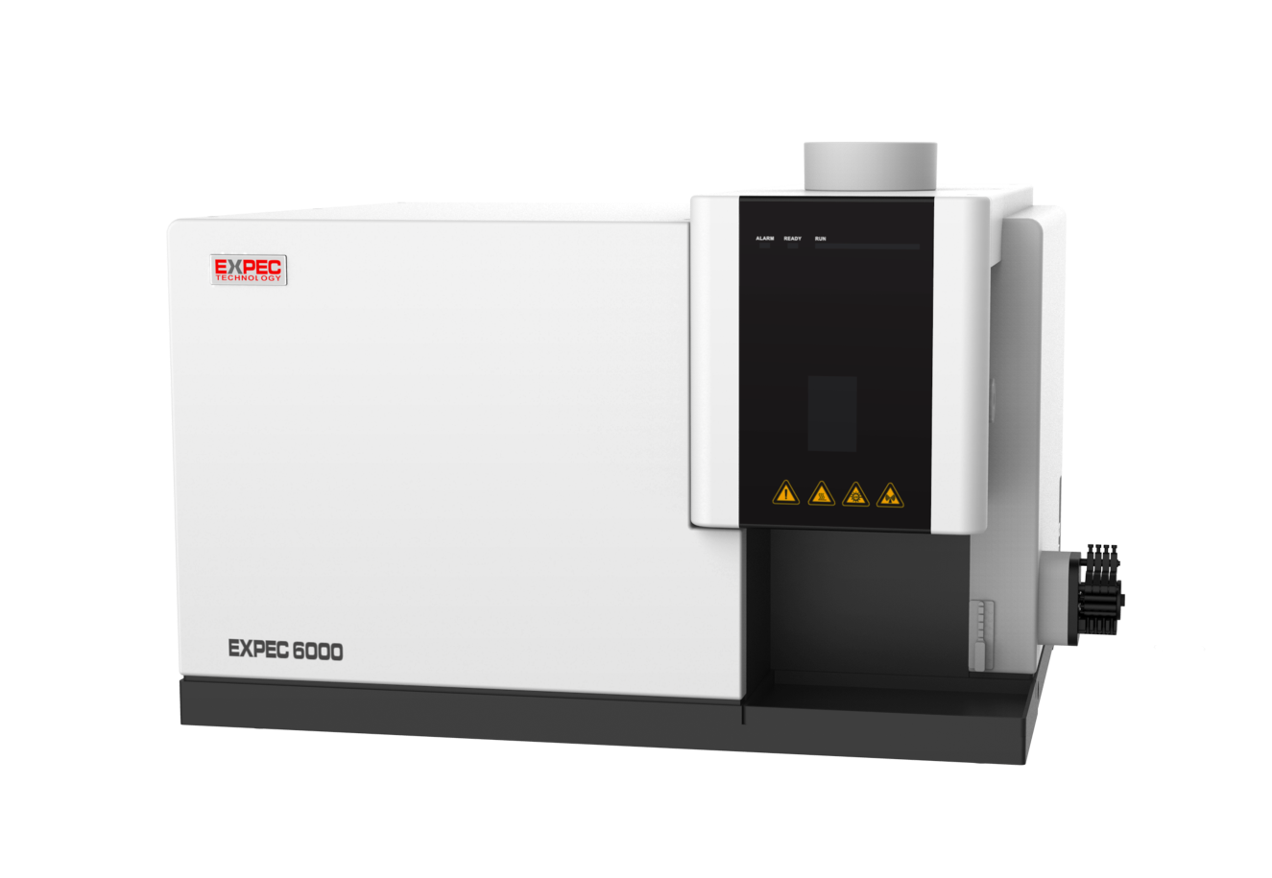
Protective type of ICP-OES SPEC Pro 6000
Split analysis system:
The sampling part, the air inlet and the door panel of the torch chamber are all sealed with anti-radiation materials;
Separate design, to ensure that the host and RF generator of the instrument are not polluted by nuclear radiation and can operate normally;
Except for the sample injection part, it can also be repaired and maintained like a common instrument, reducing the maintenance cost.
Self-excited all solid-state RF source:
Full-new frequency conversion design to realize automatic matching of plasma load;
500-1600W continuous power adjustable;
Water-cooled design, rapid heat dissipation, effectively improving reliability;
Internal power and temperature chain protection;
Power stability<0.1%.

Slide 10
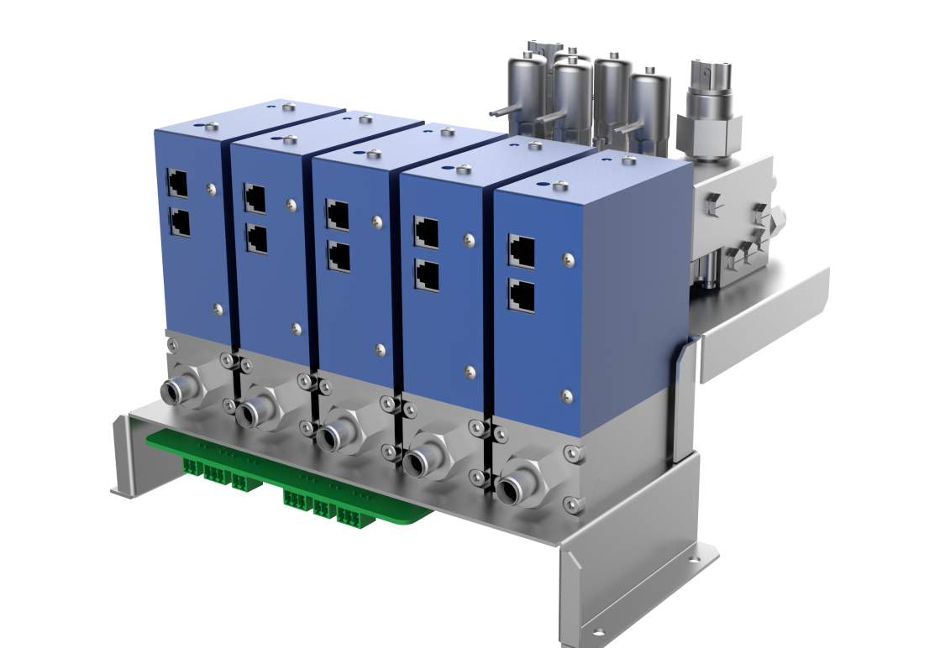
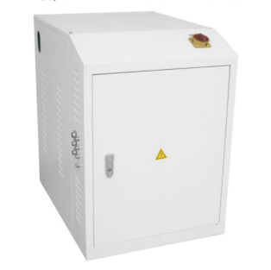
Protective type of ICP-OES SPEC Pro 6000
Stable sampling system:
High-precision 4-channel 12-rotor peristaltic pump, 64 subdivision precision control to ensure stable sample injection*
Multi-channel digital mass flow controllers can precisely control each channel of argon, with a control accuracy of 0.01L/min, ensuring the stability of measurement data
Waste recovery system:
Exhaust tail gas contains radioactive substances, which are automatically recovered and purified by the gas purification system;
The waste and liquid waste after analysis are closed and recovered to avoid radiation pollution from the nuclear industry.

Slide 11
Stable and Classic Optical Analysis System
Classical echelle two-dimensional spectroscopic system
The thermal balance control light chamber with a constant temperature of 36 degrees is the cornerstone of the stability of the instrument;
Argon hydrodynamic simulation design enables the optical system to quickly establish a high-purity argon atmosphere, realize ultraviolet analysis, and save time and argon;
The semi-isolated design of the host and the optical system balances the heat exchange, making the optical system better resist the influence of changes in the external environment
Support vehicle applications, stable and reliable
Patented real-time drift correction algorithm for micro-drift correction
Back-illuminated high-speed CCD acquisition device
High UV response, no need for UV fluorescent coating
Megapixels for a high-resolution experience
Three-stage TEC refrigeration design, extreme noise reduction and better dynamic range
Professional anti-spill design, can analyze high and low content at the same time
Light chamber temperature
Light chamber temperature fluctuation<0.2℃
5℃
30℃
Ambient temperature

Slide 12
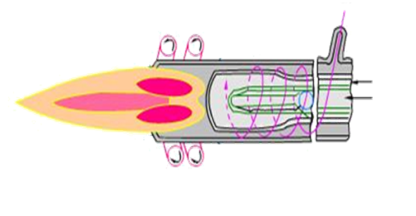
Stable and Classic Optical Analysis System
Into the seam
Collimating/imaging mirrors
Special slit design, 50 microns and 100 microns, increases luminous flux while improving resolution
Precisely designed spherical optical elements to obtain a perfect spectral map that eliminates the influence of aberrations
Prism
Large area echelle grating
High-precision echelle grating with zero expansion coefficient, high resolution and high stability
The design of the two-pass prism reduces the influence of aberration while ensuring the dispersion of the prism
Large array deep cooling CCD
Constant temperature light chamber
Large area array anti-spill CCD for scientific research applications, cooled to -45°C, eliminating noise impact
Effectively reduce spectral drift and ensure system stability

Slide 13
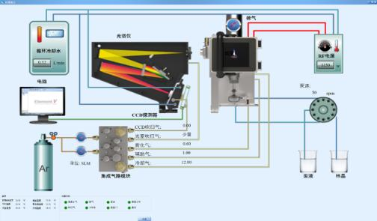
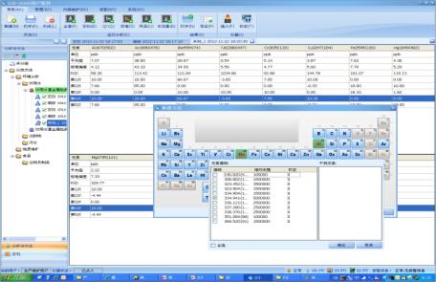
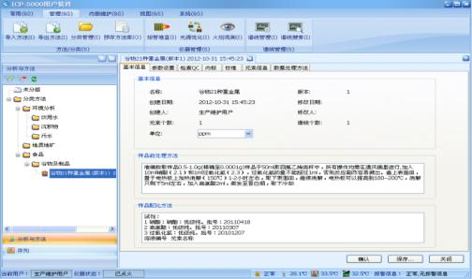
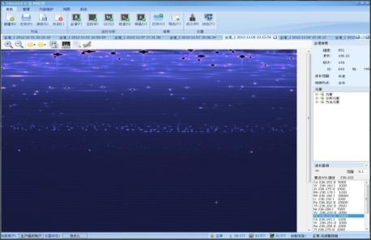
Stable and Efficient Software System -Element V
A complete method library is used as the basis to reduce the time for users to explore new methods;
Abundant processing technologies, supporting standard addition method, internal standard method, qualitative and semi-quantitative, interfering element correction and other analytical methods;
Patented self-adaptive integration algorithm, so that both high and low content can achieve better sensitivity;
With powerful expansion functions, it supports automatic sample injection, sequential sample injection, and database system docking, meeting the analysis and testing needs of modern laboratories
Remote support function
Instrument status information graph: real-time display of status information
Windows interface
Method library: method backup and import
Full Spectrum and Subarray

Slide 14
Instrument Performance Parameters
Parameters | Index | Parameters | Index
Glove box sealing level | level 2 | Detection limit | Zn213.856：1 ppb
Plasma observation method | vertical observation |  | Ni231.604：1 ppb
RF power stability | ≤0.1% |  | Mn257.610：0.5 ppb
RF frequency stability | ≤0.01% |  | Cr267.716：1 ppb
Stray light | ≤2.0 mg/L |  | Cu324.754：2 ppb
Optical resolution | ≤7 pm @200 nm |  | Ba455.403：1 ppb
Precision | RSD：≤1.0% | Stability | RSD：≤1%@2h

Slide 15
Instrument-specific Configuration
Host machine | Autosampler module | Pre-processing module (optional) | Waste recycling
Protective type ICP-OES | with closed autosampler module | with closed fully automatic graphite digester | waste recycling device, bag sealing device
 | with closed autosampler module | with closed fully automatic microwave digester | waste recycling device, bag sealing device
 | with closed autosampler module | Separat device in glove box | waste recycling device, bag sealing device

Slide 16
3
Function Introduction of SPEC Pro 6000
Part
Notes:
方案背景：如何推广“超级水站”，与常规水站不同，应聚焦“环境风险”。然后从典型水污染事件讲环境风险

Slide 17
Glove Box Function
The glove box can be customized, each module is equipped with an independent glove box, the sample is placed in the glove box, and can be operated with gloves
Box: stainless steel box, made of SUS304 stainless steel, thickness 3mm (material and thickness can be customized);
Visible window: detachable safety glass window, tempered glass thickness 8mm (customizable);
Sealing: strict sealing between the view window and the box, sealing grade 2 and with negative pressure detection table, can support remote transmission pressure;
Ventilation: with inlet air filter and air volume matching adjustment valve, inlet air duct, exhaust air duct and filter, etc.; with good ventilation;
Glove opening: two stainless steel glove openings, machined from solid bar, with strict sealing between glove opening and glove and sight window to achieve no leakage;
Transition chamber: SUS304 stainless steel, thickness 3mm. connection method is welded, no leakage;
Main bracket: steel structure bracket, installed with universal casters, reserved with four KF40 standard interfaces, configured with double-layer stainless steel shelves, safety valve to protect the equipment and materials in the glove box;
Operating system: With automatic pumping and inflating function, users only need to tap the start button on the touch screen, PLC will automatically complete the pumping and filling procedure for many times, and users can set the number of pumping and filling times, each pumping time and filling pressure.

Slide 18
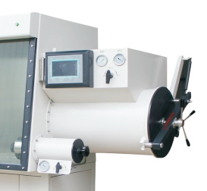
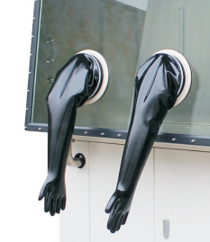
Glove Box Function
Sample access system:
Material transition module and tool transition module, the placement and transfer of samples;
Realize the leakage-free transfer of radioactive materials or highly toxic samples;
Ensure the tightness, samples, tools to radiation treatment.
Fully enclosed operating platform:
The window adopts tempered glass, which can better isolate nuclear radiation;
Gloves use radiation protection materials, and the experimenters wear gloves for sample loading and recovery operation, and for daily maintenance and treatment of instrument accessories;
It effectively guarantees the use of the experimental environment and the health and safety of the experimental personnel.

Slide 19
Glove Box Function
Glove-box penetrates:
Sample access system:
The cable is connected to the glove box through a 32-core aviation plug
The liquid circuit and gas circuit enter the glove box through the through-board ferrule joint, and the seal is sealed with an O-ring
To achieve the effect of rapid and safe replacement of gloves, especially during the replacement process, without exposing the contaminated gloves to the atmosphere or the gas in the container does not leak into the atmosphere.

Slide 20
Customized request form for protective series products
Protective type series of products | Box material | Visual window material | Sealing grade | Glove material | Air exhaust filtration system | Analyzing the host | Other configuration
Standard configuration | 3mm thickness、304 stainless steel | 8mm thickness、tempered glass | level 3 | Butyl rubber gloves | Yes, the conventional inlet and exhaust air system | / | Glove box lighting, differential voltage device, transition warehouse
Optional configuration | Stainless steel, acrylic, containing lead, other materials, etc | Tempered glass, acrylic, containing lead glass, other materials, etc | Make level 1~3 | Rubber gloves, lead gloves, etc. | Nuclear-grade filters, toxic gas filters, etc | ICP-OES | Double cover sealing device, glove box box, vacuum system, no water, no oxygen operating system, etc
Optional configuration instructions | Customize boxes of different materials and thickness according to customer requirements | According to customer requirements, different materials and thickness of the Windows can be customized | According to the actual application scenarios and analysis requirements, different sealing levels of 1~3 can be customized | Customers’ demands | According to the different application industry, with different levels of filtering system | Customize different analysis equipment according to different industries and different application analysis requirements | For different analysis and application scenario requirements, targeted configuration

Slide 21
4
Configuration and Application Case
Part
Notes:
方案背景：如何推广“超级水站”，与常规水站不同，应聚焦“环境风险”。然后从典型水污染事件讲环境风险

Slide 22
Model and Application
Specification | Description | Application cases
SPEC Pro 6000 S type | Suitable for basic protection analysis, and can realize the construction of application scenarios such as sealing, protection, and isolation under special application conditions | In the field of life sciences, biotoxicity tests of toxic and harmful chemical substances, detection and analysis of element content in biological tissues, and basic protection such as sealing to prevent toxic samples from harming the environment and analysts
SPEC Pro 6000 N type | Suitable for special protection analysis, through the construction of protective radioactive environment, to protect the safety of instrument electronic components and analysts | In the radiochemical industry, the determination of trace impurity elements in U3O8; the analysis of uranium isotope abundance and content in UF6, through special protection against radiation, reduces damage to instrument components and prevents hazards to analysts
Customized type | Suitable for flexible and customized protection analysis, through the construction of vacuum, no water, anaerobic, anaerobic, sealing and other environments, to achieve specific application scenarios | In the field of medical disease control, the detection and analysis of radioisotopes in nuclear medicine; the content of impurity elements in silica sol in semiconductor processes, through customized protection and application environment, reduce the damage of samples to instrument components and the safety of analysts

Slide 23
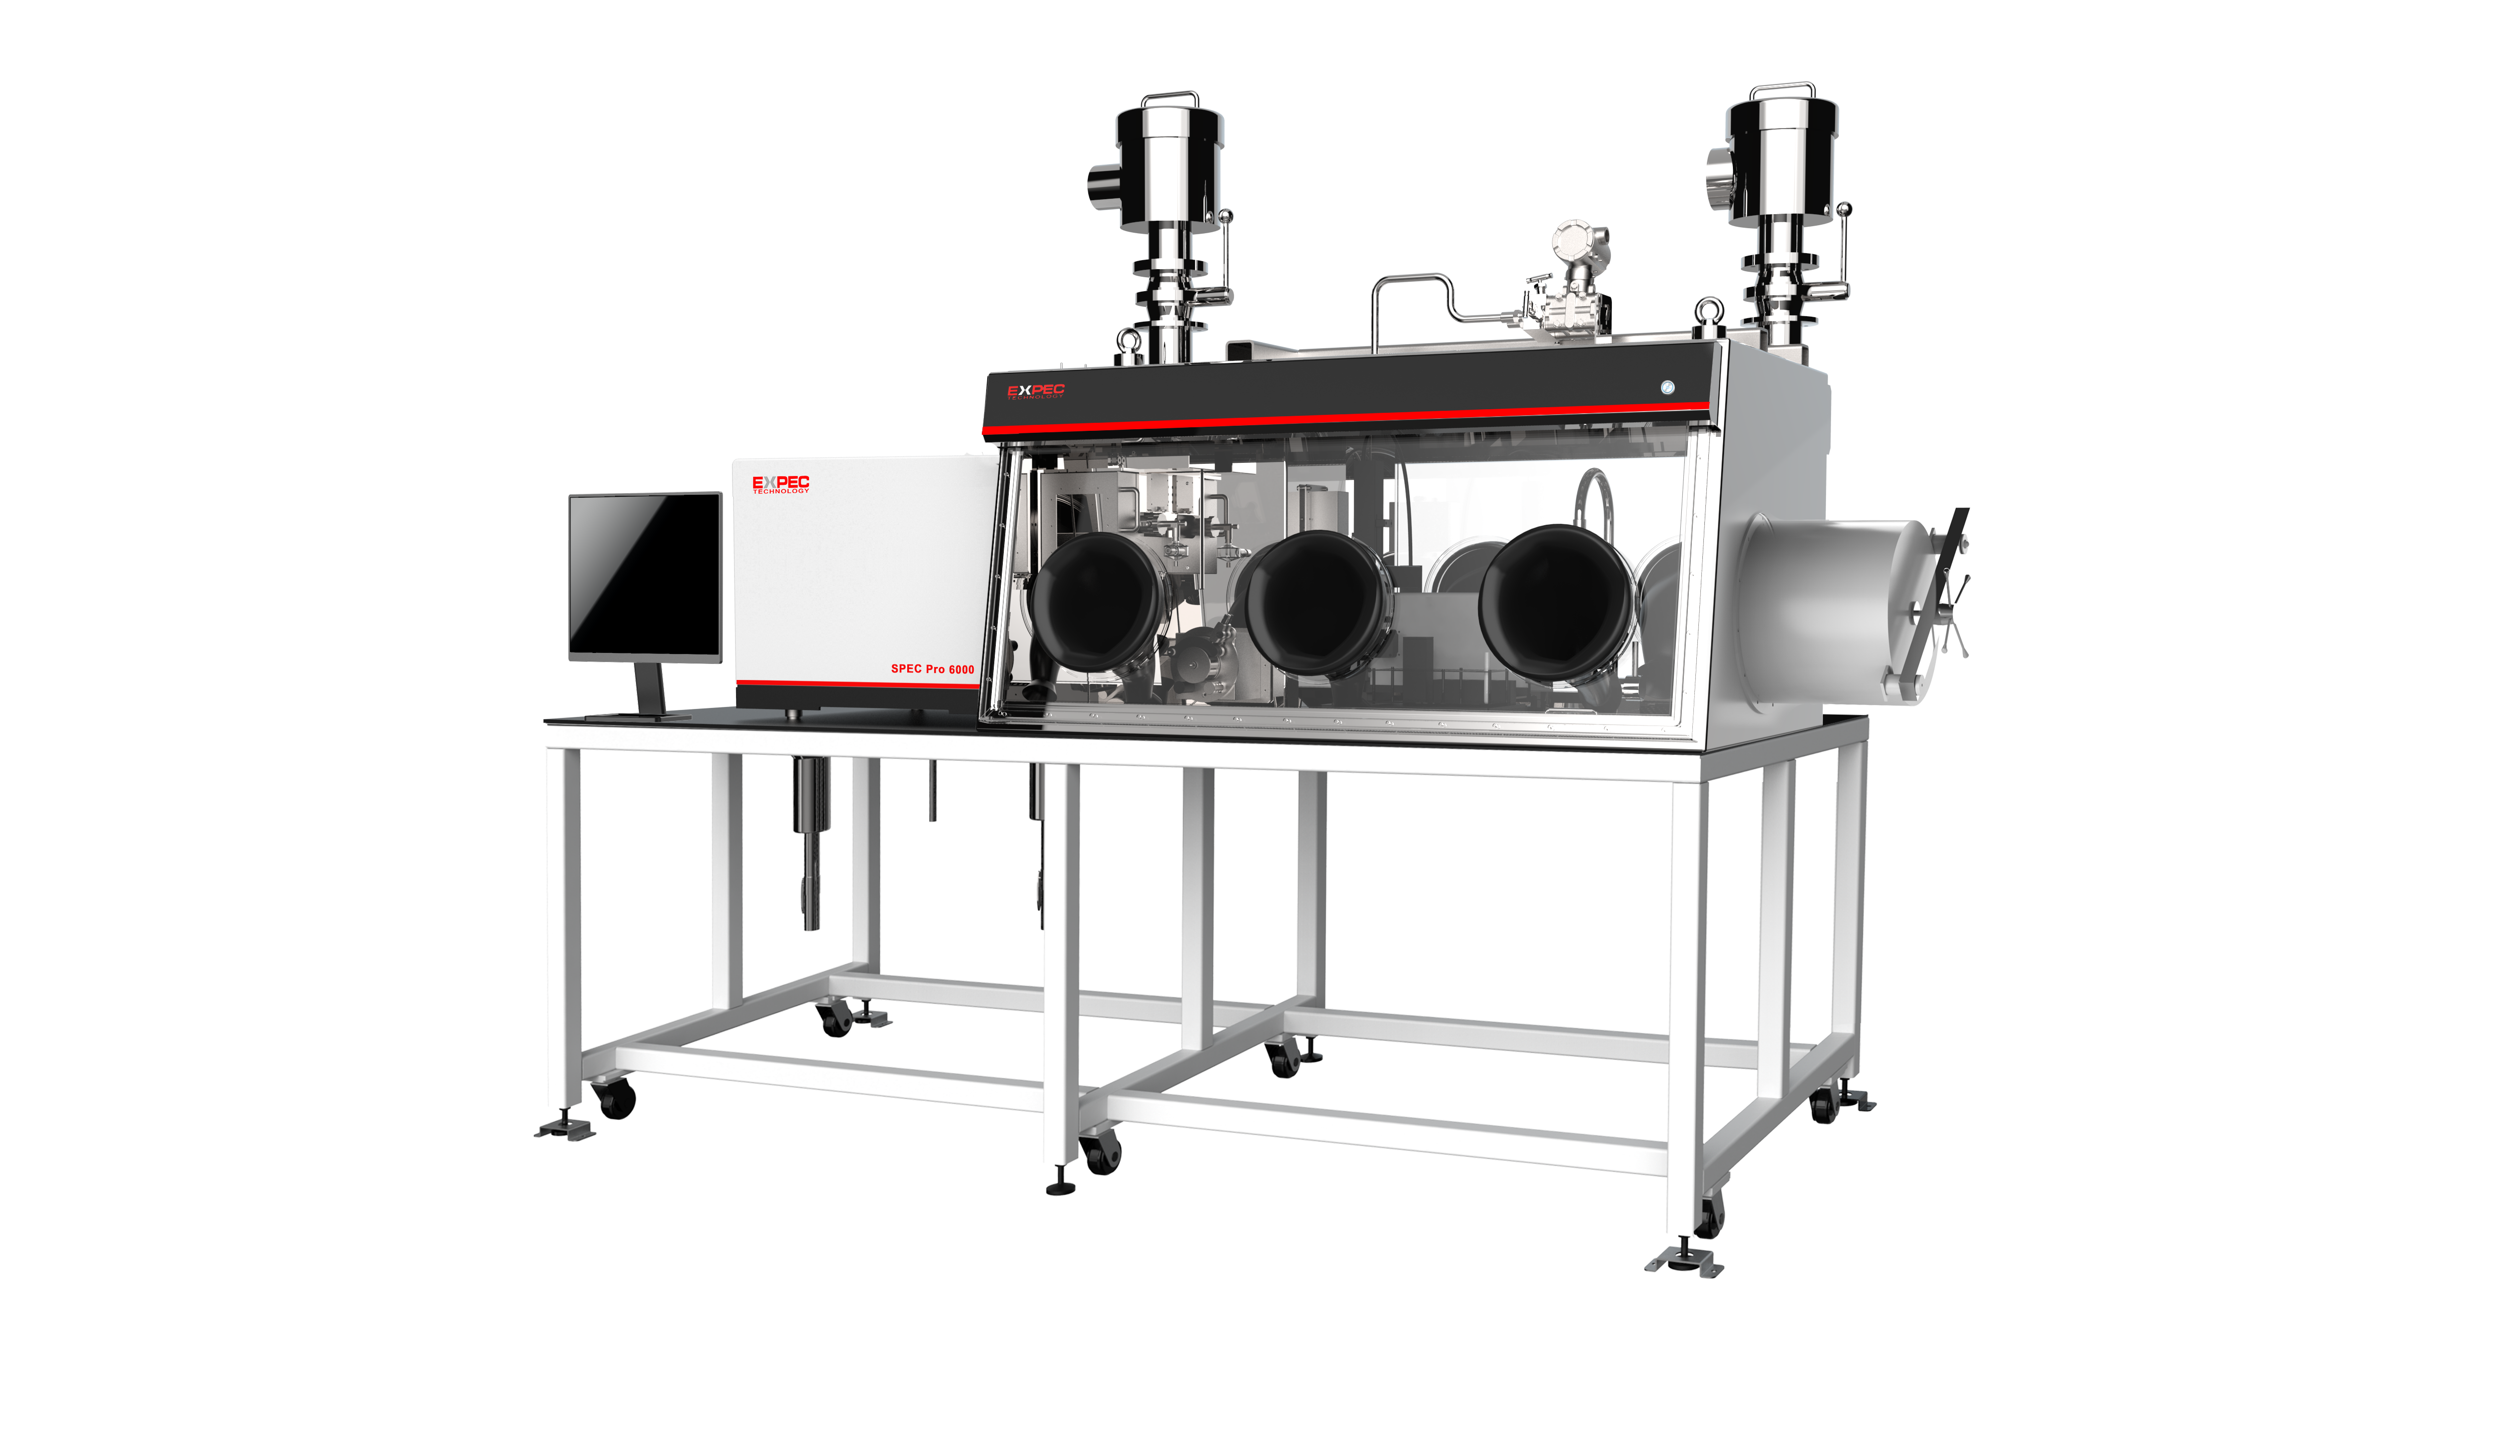
Cases：XXXX Company in China
Protective type ICP-OES
(Elemental analysis of medium and low radioactive samples)
(1) For simultaneous analysis and measurement of non-volatile elements, such as Ag, Al, As, B, Ba, Be, Ca, Cr, Co, Cu, Dy, Eu, Fe, Gd, Hf, Li, Mg, Mn, Mo, Nb, Ni, P, Ru, S, Sn , Sm, Ta, Sb, V, Ti, Zn, Zr, W.
(2) The equipment has biological shielding and radioactive containment functions, which can effectively shield β、γ and other radiation from the sample itself, and meet the radiation protection requirements.
(3) The computer (data analysis and instrument control) connected with the glove box type ICP-AES transmits the relevant information of the measurement to the laboratory information management system (LIMS) of the analysis center.

Slide 24
Thank you for watching!

