Slide 1
SPEC Pro 7000 protective type inductively coupled plasma mass spectrometer
Hangzhou EXPEC Technology Co., LTD

Slide 2
Catalogue
1
SPEC Pro 7000 system composition
2
Design features and instrument performance
3
Function introduction of SPEC Pro 7000
4
Configuration and application cases

Slide 3
1
SPEC Pro 7000 system composition
Part
Notes:
Background: How to promote "super water station", different from conventional water stations, should focus on "environmental risk". Then introduce environmental risks from typical water pollution events

Slide 4
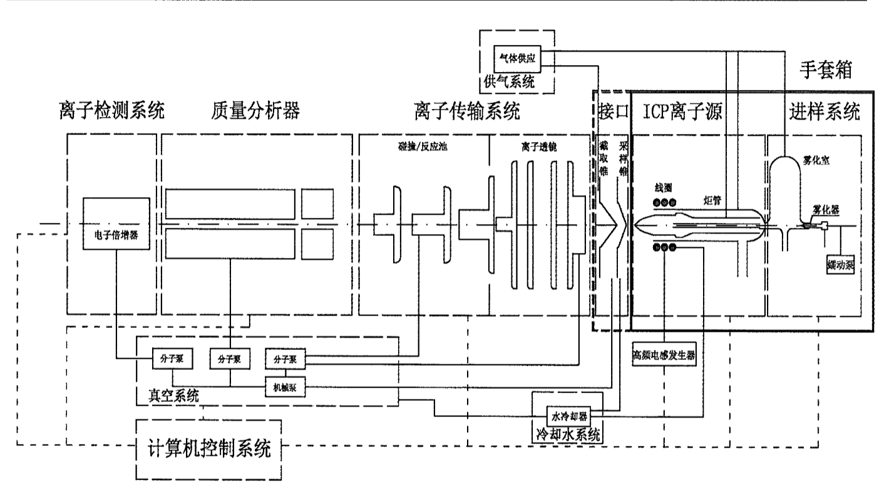
System composition diagram
Inductively coupled plasma mass spectrometer (glove box type) system includes injection system, ion source, interface, ion transmission system, mass analyzer, ion detection system, computer control system, vacuum system, cooling system, gas supply system, exhaust system, glove box, etc.
Notes:
Redrawing

Slide 5
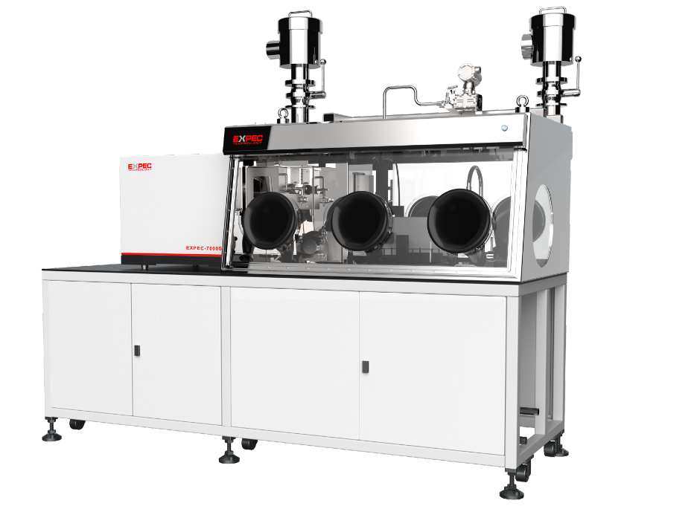
Protective type of ICP-MS SPEC Pro 7000
SPEC Pro 7000 protective inductively coupled plasma mass spectrometer, using a split design, the inductively coupled plasma mass spectrometer and glove box combination, sample contact parts in the glove box chamber, through the glove mounted on the wall of the chamber to operate the sample inside the chamber, to play the role of dust, radiation protection. It can be used in food, biological, nuclear industry, etc.
Air exhaust filter
Unique design of exhaust pipe to ensure that exhaust gas does not enter the laboratory and prevent laboratory contamination
Sample access to the system
It can be used with fully automatic pretreatment equipment
Material transition compartment and tool transition compartment, placement and delivery of samples
Mature analytical techniques
Mature element analysis technique based on ICP-MS
Closed operating space
Split design
Seal off the operating environment of the glove box
Instrument automatic ignition, automatic optimization,
automatic calibration curve, automatic quality control
The host actively starts, optimizes, and prepares for the analysis
Standard solution automatic introduction, quality control includes detection limit, standard sample, blank and other choices, to ensure the reliability of data
Closed digestion system and waste recycling
Lead glass is used. Stainless steel and other materials are used to enclose the digestion chamber and to recover waste and waste liquid after analysis to avoid pollution.

Slide 6
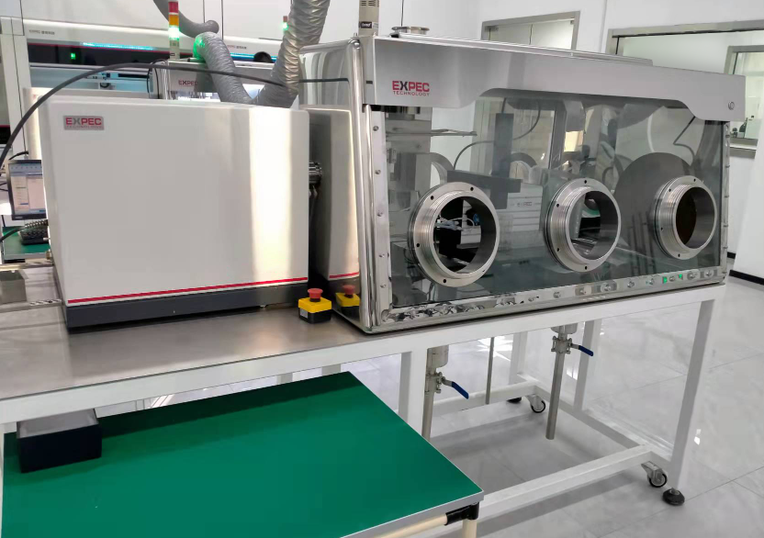
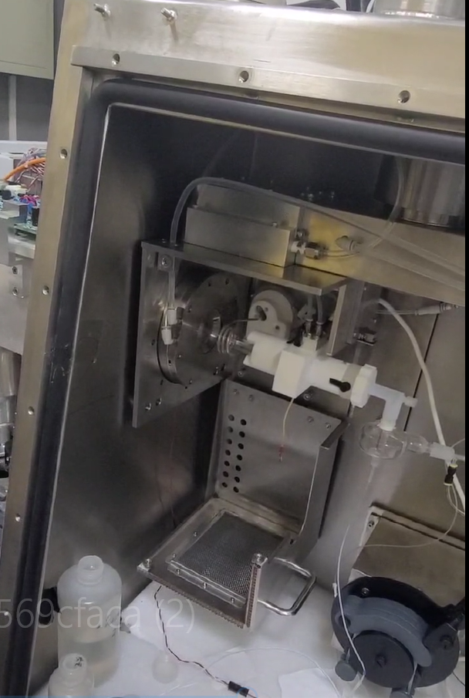
Protective type of ICP-MS SPEC Pro 7000
The 7000S physical picture
Rectangle chamber structure

Slide 7
2
Design features and instrument performance
Part
Notes:
Background: How to promote "super water station", different from conventional water stations, should focus on "environmental risk". Then introduce environmental risks from typical water pollution events

Slide 8
design feature
Ion channel design -Ion channel between instrument and glove box to achieve sealed design
Torch chamber design - Torch chamber door adopts straight pull design, ionization prevention, easy to open and close
RF power supply design -RF power supply module is separately encapsulated in the back panel of the glove box in a shaped place
Penetration design -Integrated design of the penetration ensures hermeticity
Glove box design - Customized glove box, the box can achieve a variety of closed environment
Easy accessory replacement and maintenance - Easy maintenance and replacement of instrument components in the glove box to reduce maintenance costs

Slide 9
Protective type ICP-MS SPEC Pro 7000, host machine performance
Excellent, sensitivity & precision
Excellent matrix resistance performance
According to the aerodynamic simulation design at the junction of thermal plasma and vacuum, the ion interface is optimized, which greatly improves the sensitivity of ICP-MS by 3~5 times. The detection limit as low as ppt is more suitable for the detection of high purity materials and high purity reagents.
Key technologies such as fluid simulation ion interface, two off-axis design, patented collision reaction pool, powerful self-exciting all-solid ICP ion source and argon online dilution ensure that SUPEC 7000S has excellent matrix resistance, and 10% of high-salt samples can be injected directly.
Sensitivity in the standard mode
Instrument detection limit
Low mass number (Li):> 50 Mcps / ppm
Medium mass number (In):> 300 Mcps / ppm
High mass number (U):> 350 Mcps / ppm
Light mass element: <3 ppt
Medium mass number element: <0.1ppt
High-quality number element: <0.2ppt
Instrument stability
Short-term stability (RSD): <2% (20min)
Long-term stability (RSD): <3% (2h)
The technical index and reliability reach the international mainstream ICP-MS, commodity instrument level
Notes:
Redrawing

Slide 10
Protective ICP-MS SPEC Pro 7000, product features
Efficient sample injection system
Stable ICP, and the ion source
Reliable double-conical ion interface
Split torch tube
Patent of the self-excited
all-solid-state ICP, ion source
Optimize the ion interface design
Full MFC gas control system
Through the aerodynamic simulation
iStandby pattern
Extract the lens
Argon gas in-line dilution system
Minimalist cone-changing system
Composite ion transport system
High-speed dynamic collision reaction pool
High-precision quadrupole mass analyzer
Unique ion channels
Patted distributed collision / reaction
gas diffusion
Unique pure molybdenum
quadrupole rod
Open-type ion
deflection lens
Provides excellent interference
removal capabilities
MS RF power supply with temperature
and humidity resistance

Slide 11
3
Function introduction of SPEC Pro 7000
Part
Notes:
Background: How to promote "super water station", different from conventional water stations, should focus on "environmental risk". Then introduce environmental risks from typical water pollution events

Slide 12
SPEC Pro 7000 Glove-box function
Customizable glove box, each module is equipped with independent glove box, samples are placed in the glove box, can be operated by gloves
▶Box: stainless steel box, material SUS304 stainless steel, thickness 3mm.
▶Viewable window: removable safety glass window, toughened glass thickness 8mm.
▶Sealing: strict sealing between the view window and the box, sealing grade 2 and with negative pressure detection table, can support remote transmission pressure.
▶Ventilation: with inlet air filter and air volume matching adjustment valve, inlet air duct, exhaust air duct and filter, etc.; with good ventilation
▶Glove opening: two stainless steel glove openings, machined from solid bar, with strict sealing between glove opening and glove and sight window to achieve no leakage;
▶Transition chamber: SUS304 stainless steel, thickness 3mm. connection method is welded, no leakage.
▶Main bracket: steel structure bracket, installed with universal casters, reserved with four KF40 standard interfaces, configured with double-layer stainless steel shelves, safety valve to protect the equipment and materials in the glove box.
▶Operating system: With automatic pumping and inflating function, users only need to tap the start button on the touch screen, PLC will automatically complete the pumping and filling procedure for many times, and users can set the number of pumping and filling times, each pumping time and filling pressure.

Slide 13
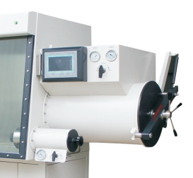
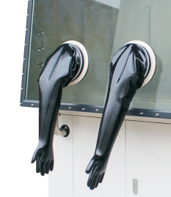
Glove box function
Sample access system:
Material transition module and tool transition module, the placement and transfer of samples;
Realize the leakage-free transfer of radioactive materials or highly toxic samples;
Ensure the tightness, samples, tools to radiation treatment.
Fully enclosed operating platform:
The window adopts tempered glass, which can better isolate nuclear radiation;
Gloves use radiation protection materials, and the experimenters wear gloves for sample loading and recovery operation, and for daily maintenance and treatment of instrument accessories;
It effectively guarantees the use of the experimental environment and the health and safety of the experimental personnel.

Slide 14
Glove box function
Glove-box penetrates:
The waterway, circuit and gas circuit interfaces enter the glove box through the special interface board on the glove box, the cable is connected to the glove box through the 32-core aviation plug, the liquid circuit and gas circuit enter the glove box through the board sleeve connector, and the seal is sealed by O-ring
Sample access system:
To achieve the effect of rapid and safe replacement of gloves, especially during the replacement process, without exposing the contaminated gloves to the atmosphere or the gas in the container does not leak into the atmosphere.

Slide 15
Customized request form for protective series products
Protective type series of products | Box material | Visual window material | Sealing grade | Glove material | Air exhaust filtration system | Analyzing the host | Other configuration
standard layout | 3mm thickness, 304 stainless steel | 8mm thickness, tempered glass | Level 3 | butyl rubber gloves | Yes, the conventional inlet and exhaust air system | / | Glove box lighting, differential voltage device, transition warehouse
Optional configuration | Stainless steel, acrylic, containing lead, other materials, etc | Tempered glass, acrylic, containing lead glass, other materials, etc | Make level 1~3 | Rubber gloves, lead gloves, etc | Nuclear-grade filters, toxic gas filters, etc | ICP-MS | Double cover sealing device, glove box box, vacuum system, no water, no oxygen operating system, etc
Optional configuration instructions | Customize boxes of different materials and thickness according to customer requirements | According to customer requirements, different materials and thickness of the Windows can be customized | According to the actual application scenarios and analysis requirements, different sealing levels of 1~3 can be customized | VOC | According to the different application industry, with different levels of filtering system | Customize different analysis equipment according to different industries and different application analysis requirements | For different analysis and application scenario requirements, targeted configuration

Slide 16
4
Configuration and application cases
Part
Notes:
Background: How to promote "super water station", different from conventional water stations, should focus on "environmental risk". Then introduce environmental risks from typical water pollution events

Slide 17
Protective type ICP-MS application
Glove box ICP-MS has good sensitivity, lower detection limit, and considerable advantages in the detection of trace elements, so its application in the nuclear industry and nuclear environment industry has gradually developed. In recent years, whether from the performance of ICP-MS instrument itself, or from the means and methods of analysis and testing have been significantly improved.
ICP-MS is applied to the relevant standards in the nuclear industry and the nuclear environment industry
Standard number | Standard name | object element
DZ/T 0279.6-2016 | Regional geochemical sample analysis methods — Part 6: Determination of uranium content by inductively coupled plasma mass spectrometry | U
SN/T 4678-2016 | Determination of uranium and thorium in exported food method Inductively coupled plasma mass spectrometry | U 、Th
DB15/T 688.4-2014 | Methods for chemical analysis of thorium dioxide powder-Part 4: Determination of uranium, hafnium, antimony and bismuth in thorium dioxide powder-inductively coupled plasma mass spectrometry | U 、Hf 、Sb 、Bi
GB/T 12690.12-2003 | Chemical analysis of non-rare earth impurities in rare earth metals and their oxides Determination of thorium azo III spectrophotometry and inductively coupled plasma mass spectrometry | Th
GB/T 16484.20-2009 | Chemical analytical methods for rare earth chloride and light rare earth carbonate- -Part 20: Determination of the amount of nickel oxide, manganese oxide, lead oxide, alumina, zinc oxide and thorium oxide Inductively coupled plasma mass spectrometry | Nickel oxide, manganese oxide, lead oxide, aluminum oxide, zinc oxide, thorium oxide

Slide 18
Model and application
specifications | description | application case
SPEC Pro Type 7000S | It is suitable for basic protection analysis and can realize the construction of application scenarios such as isolation and sealing under special application conditions | In the petrochemical industry, direct injection and rapid detection of excessive trace mercury, lead, arsenic and other elements, to prevent the harm of volatile samples to the environment and analysts through sealing and other basic protection
SPEC Pro 7000N type | Suitable for special protection analysis, through the construction of protective radioactive environment, to protect the safety of instrument electronic components and analysts | In the radiochemical industry, the content analysis of trace uranium, plutonium, and other elements in reprocessed fuels, and the protective effect of glove boxes on radioactive samples
customized | Suitable for flexible and customized protection analysis, through the construction of vacuum, no water, anaerobic, anaerobic, sealing and other environments, to achieve specific application scenarios | Rapid determination of cadmium and mercury in agricultural products by solid feed electrothermal evaporation for the analysis of heavy metal contamination in agriculture in the life sciences, with customized protection against mercury vapor from solid evaporation to reduce the risk to instrument components and analysts to instrument components and analysts

Slide 19
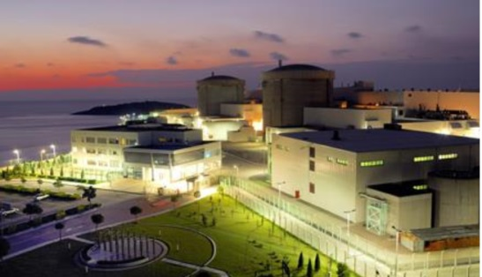
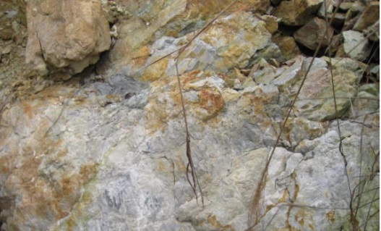
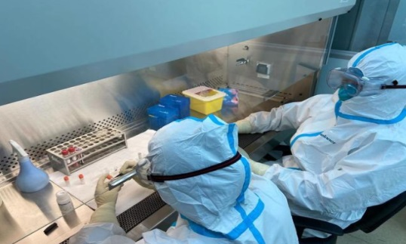
Application scenarios of protective type fully automatic analytical instrument
Nuclear industry: detection and analysis of radioactive samples
Mineral resources: no oxygen, vacuum, negative pressure and other environmental detection and analysis
Qualitative, quantitative analysis of the radioactive elements
Rapid analysis of trace plutonium and concentration and its isotopes; the sample type is nitric acid system or TBP / kerosene system
Simultaneous analysis of multiple elements in the standard rock samples
Determination of trace and trace elements in various geological samples
Disease control: bioprotective sample detection and analysis
Biopharmaceutical safety: sterile environment detection and analysis
Food poisoning, environmental pollution, occupational poisoning and other public health emergencies of physical and chemical inspection and testing
Public environment, occupational hazards and food, cosmetics, disinfection products, water-related products and other health-related physical and chemical testing
Content analysis of drugs
Analysis of the purity of drug active substances
Chromium, Cl-l, SO₄²- and other impurity limit analysis

Slide 20
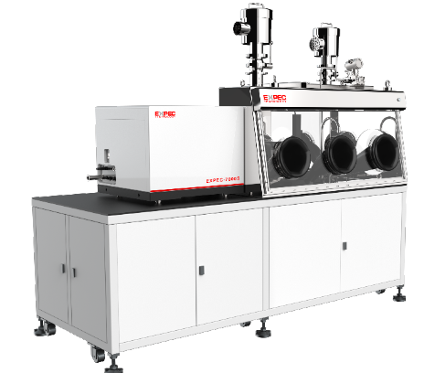
Application examples of protective ICP-MS in the nuclear industry and nuclear environment
Elemental analysis of medium and low radioactive samples
Mainly used for the rapid analysis of trace plutonium and concentration and its isotopes;
Sample type was nitric acid system or TBP / kerosene system.
The main functions of glove box type ICP-AES include:
(1) the analysis of Ag, Al, As, B, Ba, Be, Ca, Cr, Co, Cu, Dy, Eu , Fe Gd, Hf, Li,
Mg, Mn, Mn, Mo, Nb, Ni, P, Ru, S, Sn, Sm, Ta Sb, V, Ti, Zn, Zr, W and other
non-volatile elements for simultaneous analysis and detection.
(2) The equipment has the function of biological shielding and radioactive
inclusion, which can effectively shield the β, γ and other radiation from the
sample itself to meet the demand of radiation protection.

Slide 21
Thank you for watching!

